Slide 1
Application Architecture
James Chambers | Senior Software Developer
Simon Timms | Senior Software Developer

Slide 2
Course Topics
Applications on Azure: Putting the Pieces Together
01 | Introduction | 05 | Azure Storage
02 | Application Architecture | 06 | Docker and Log Management
03 | DNS | 07 | AutoScale
04 | Batch | 08 | Review and Summary
Applications on Azure: Putting All the Pieces Together
01 | Intro | 05 | Storing Data and Objects in Azure
02 | Exploring Application Architecture | 06 | ElasticSearch, Docker and YOU
03 | Working with Azure DNS Services | 07 | Scaling Your Application Under Load
04 | Executing Large Tasks in the Cloud | 08 | Rewind

Slide 3
Course Topics
Applications on Azure: Putting the Pieces Together
01 | Introduction | 05 | Azure Storage
02 | Application Architecture | 06 | Docker and Log Management
03 | DNS | 07 | AutoScale
04 | Batch | 08 | Review and Summary
Applications on Azure: Putting All the Pieces Together
01 | Intro | 05 | Storing Data and Objects in Azure
02 | Exploring Application Architecture | 06 | ElasticSearch, Docker and YOU
03 | Working with Azure DNS Services | 07 | Scaling Your Application Under Load
04 | Executing Large Tasks in the Cloud | 08 | Rewind

Slide 4
Module Overview

Slide 5
Module Overview
The story so far
The building blocks
Mediator with MediatR
Authentication

Slide 6
The Story so Far

Slide 7
A trip to the parts bin
Monolithic applications are
Tough to maintain
Not very fault tolerant
Difficult to scale

Slide 8
A trip to the parts bin
Instead let’s try
Smaller services
Communication using messaging
Fault tolerance

Slide 9
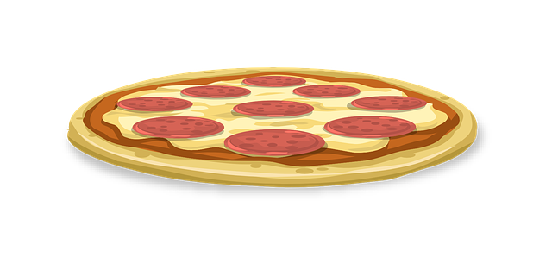
Microservices?
Microservices are
Componentized via services
Single purpose
Isolated storage
Resilient to failure
Generally small

Slide 10
Resilient Communication
Making use of messaging
Asynchronicity

Slide 11
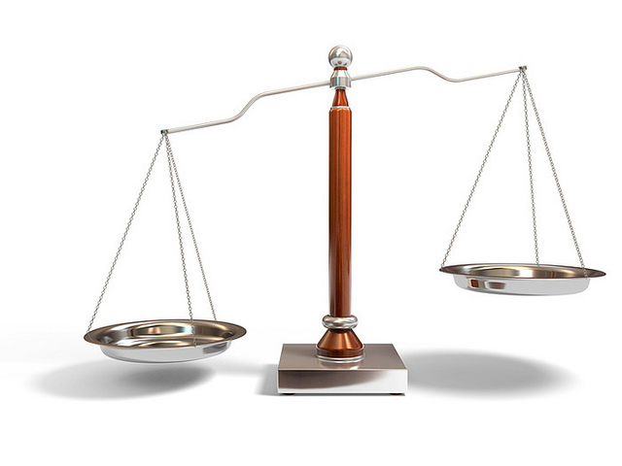
Finding the balance between resilience and ease of programming
https://www.flickr.com/photos/61056899@N06/5751301741

Slide 12
Out of process messaging
Greater resiliency to failure
Easier to distribute and scale
Can be coupled with CQRS to support multiple read models
However…
Common UI paradigms don’t work well (add record and show list)
Not all that easy

Slide 13
CQRS?
Splitting read and write models
Have multiple read models to facilitate different views of data
Easy to support polyglot persistence
Check out the CQRS Journey https://cqrsjourney.github.io/
MVA: Designing Applications for Windows Azure Jump Start

Slide 14
The Building Blocks

Slide 15
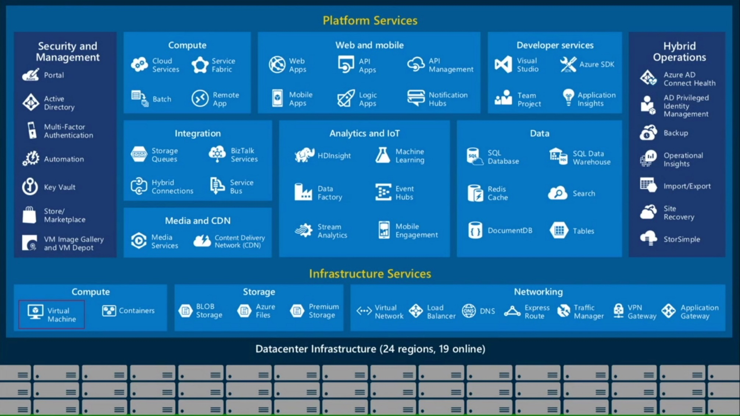
Our Building Blocks

Slide 16
imagenomnom.com

Slide 17
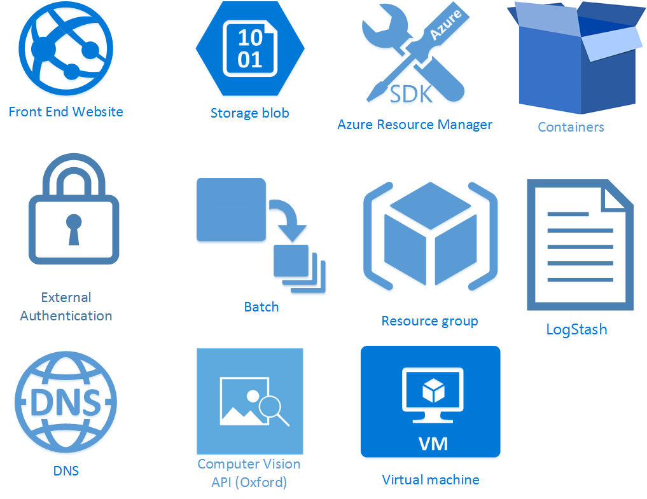

Slide 23
Notes:
Drop over to the website and demo how nifty it is that oxford can do things with images

Slide 24
Notes:
Json based, can configure most services in a declarative fashion. What does that mean?

Slide 29
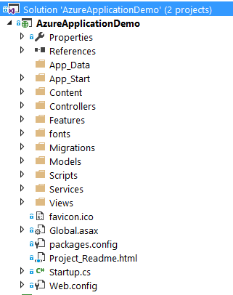
Web Application

Slide 30
Mediator with MediatR

Slide 31
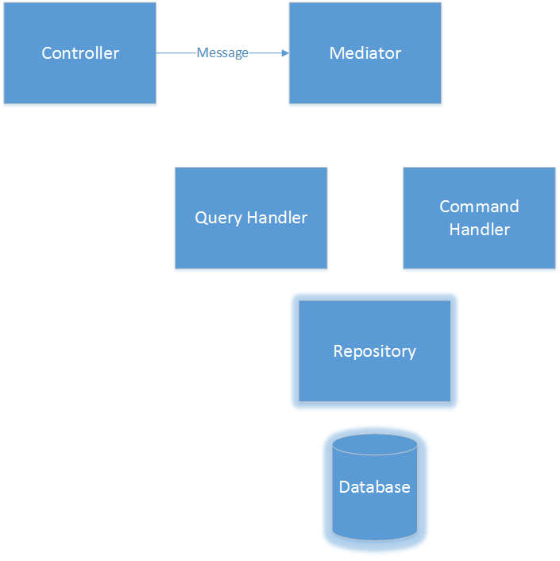
MediatR

Slide 32
MediatR
Validate

Slide 33

MediatR

Slide 34

MediatR

Slide 35

MediatR

Slide 36
MediatR

Slide 37
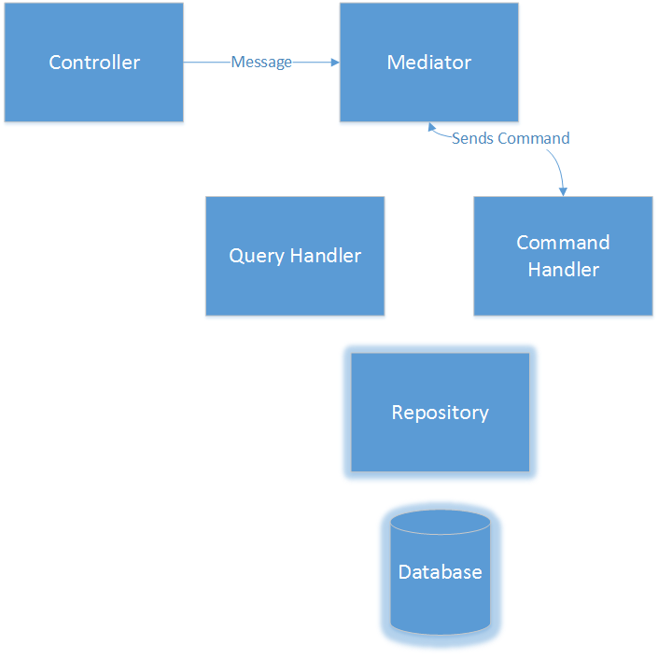
MediatR

Slide 38

MediatR

Slide 39
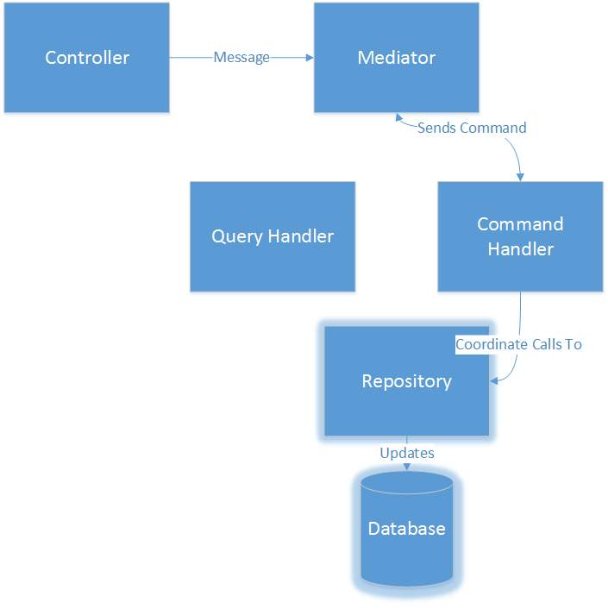
MediatR

Slide 40
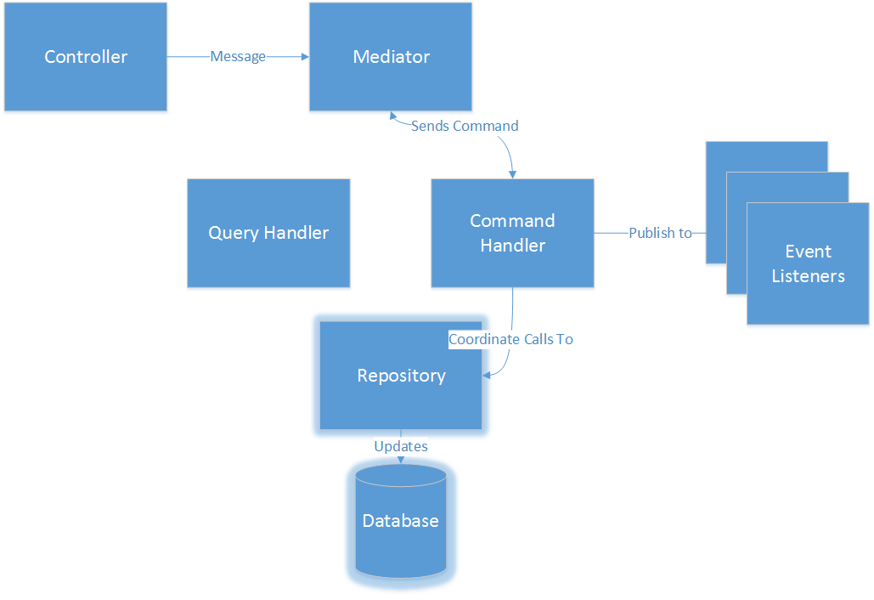
MediatR
Notes:
Event listeners perform dependent actions – update other views, publish messages on external busses, notify users

Slide 41
MediatR – How do we arrange code?
Notes:
Drop to visual studio

Slide 42
Authentication

Slide 43


Twitter Authentication
http://bmj2k.com/2013/06/21/imponderable-98-lomza-poland/
http://balzanomichele.blogspot.ca/p/password.html
Notes:
There have been a lot of passwords stolen as of late. No matter how good your password security there could be a flaw which will let criminals <space> to steal your passwords or other user details.

Slide 44
Twitter Authentication
?
http://bmj2k.com/2013/06/21/imponderable-98-lomza-poland/
Notes:
Instead of storing passwords why don’t we just keep them somewhere else? We can use a service like twitter to do our authentication for us. That way when the criminals come calling there is nothing for them to steal.

